Slide 1
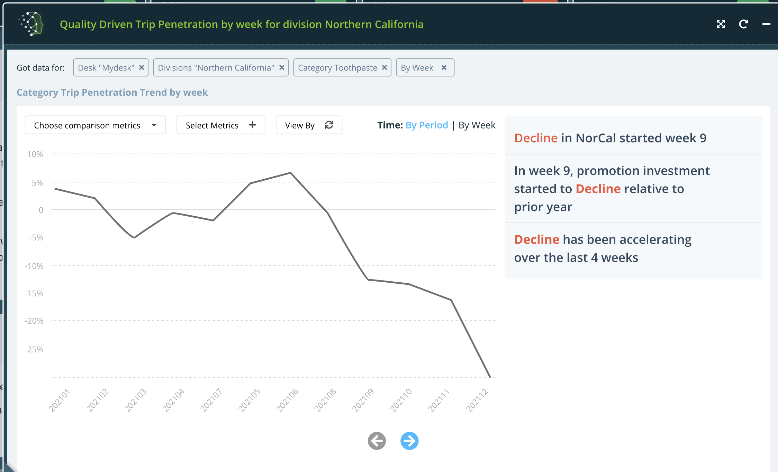
Key ingredients to deliver “Insights” (and data driven stories)

Slide 2

Key ingredients to deliver “Insights” (and data driven stories)
1
KEY MESSAGE
We need an idea, a focus on the message that we want to deliver
Define the INTENT

Slide 3
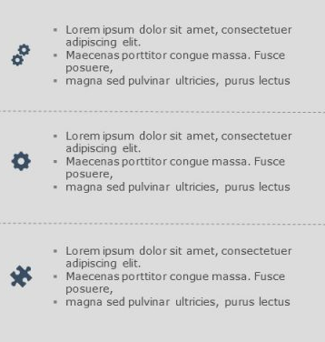
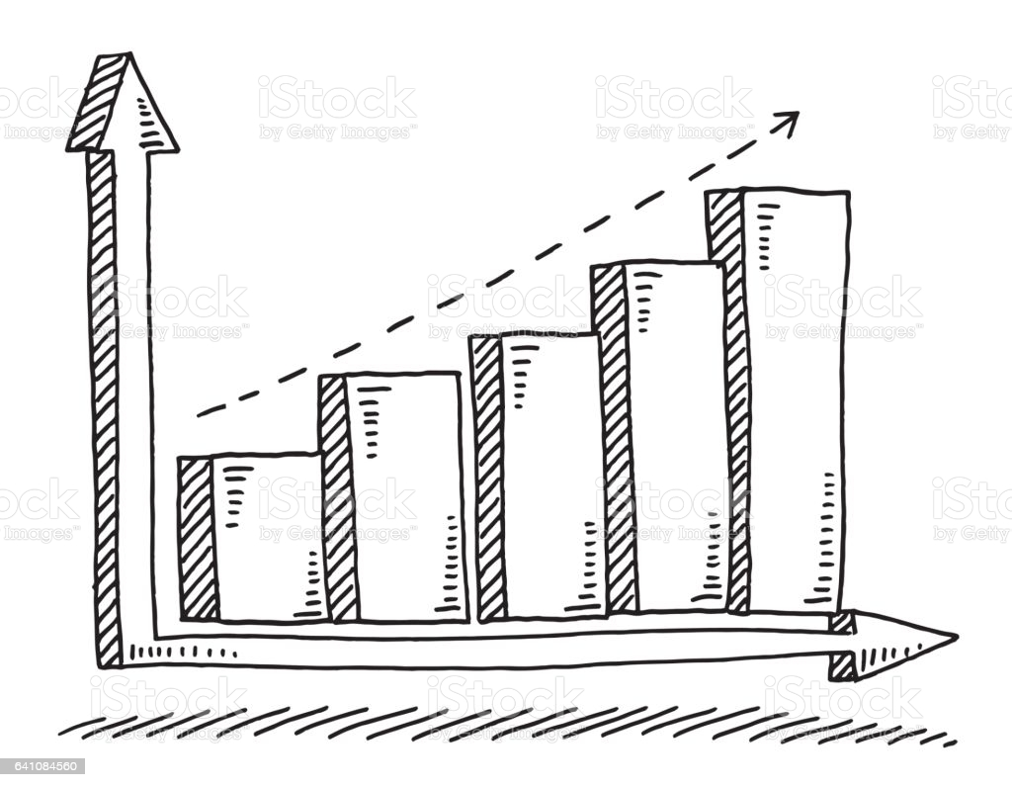
Key ingredients to deliver “Insights” (and data driven stories)
We sketch the key visual elements and KEY INSIGHTS that will help to deliver the message
2

Slide 4
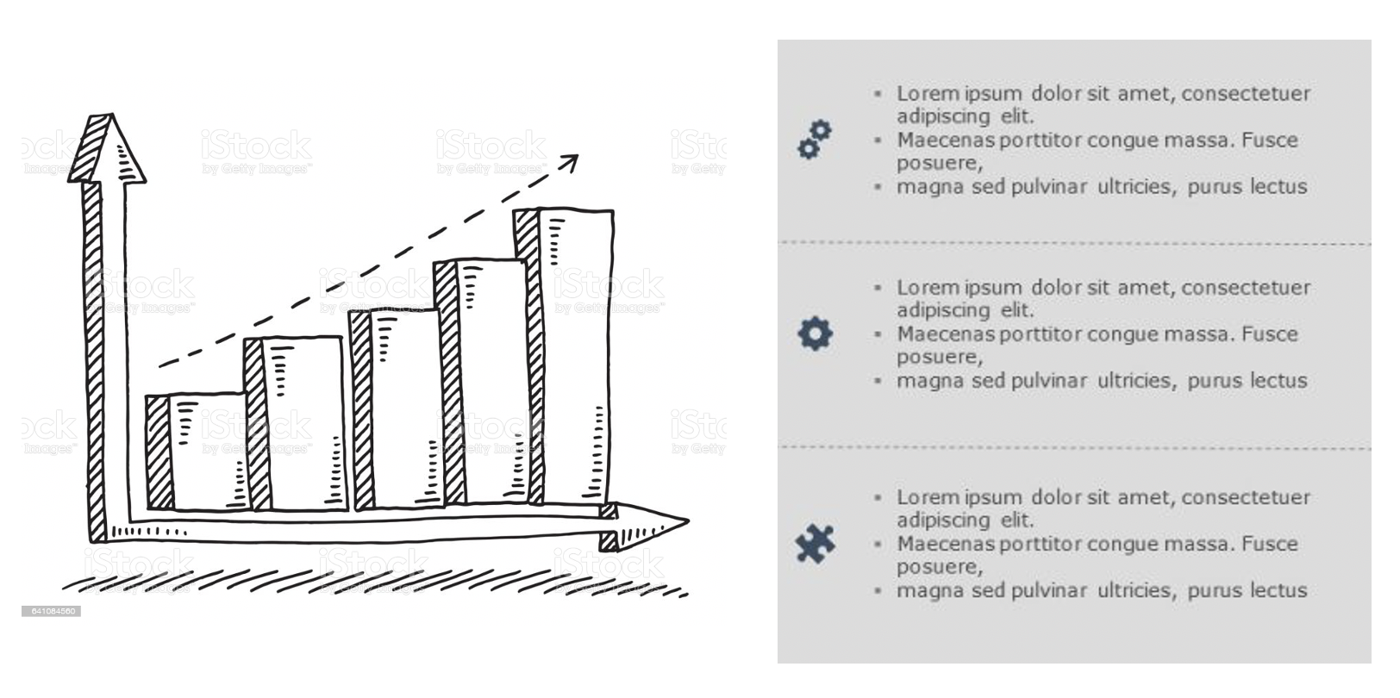



Key ingredients to deliver “Insights” (and data driven stories)
We define & deliver the data that feeds our story
Data that Drives the story
3
Process data to feed key messages (insights)
Core Data that Drives the story
Getting the right source data

Slide 5
Key ingredients to deliver “Insights” (and data driven stories)
Bring UI to life with data (first dummy and then real data)
4

Slide 6
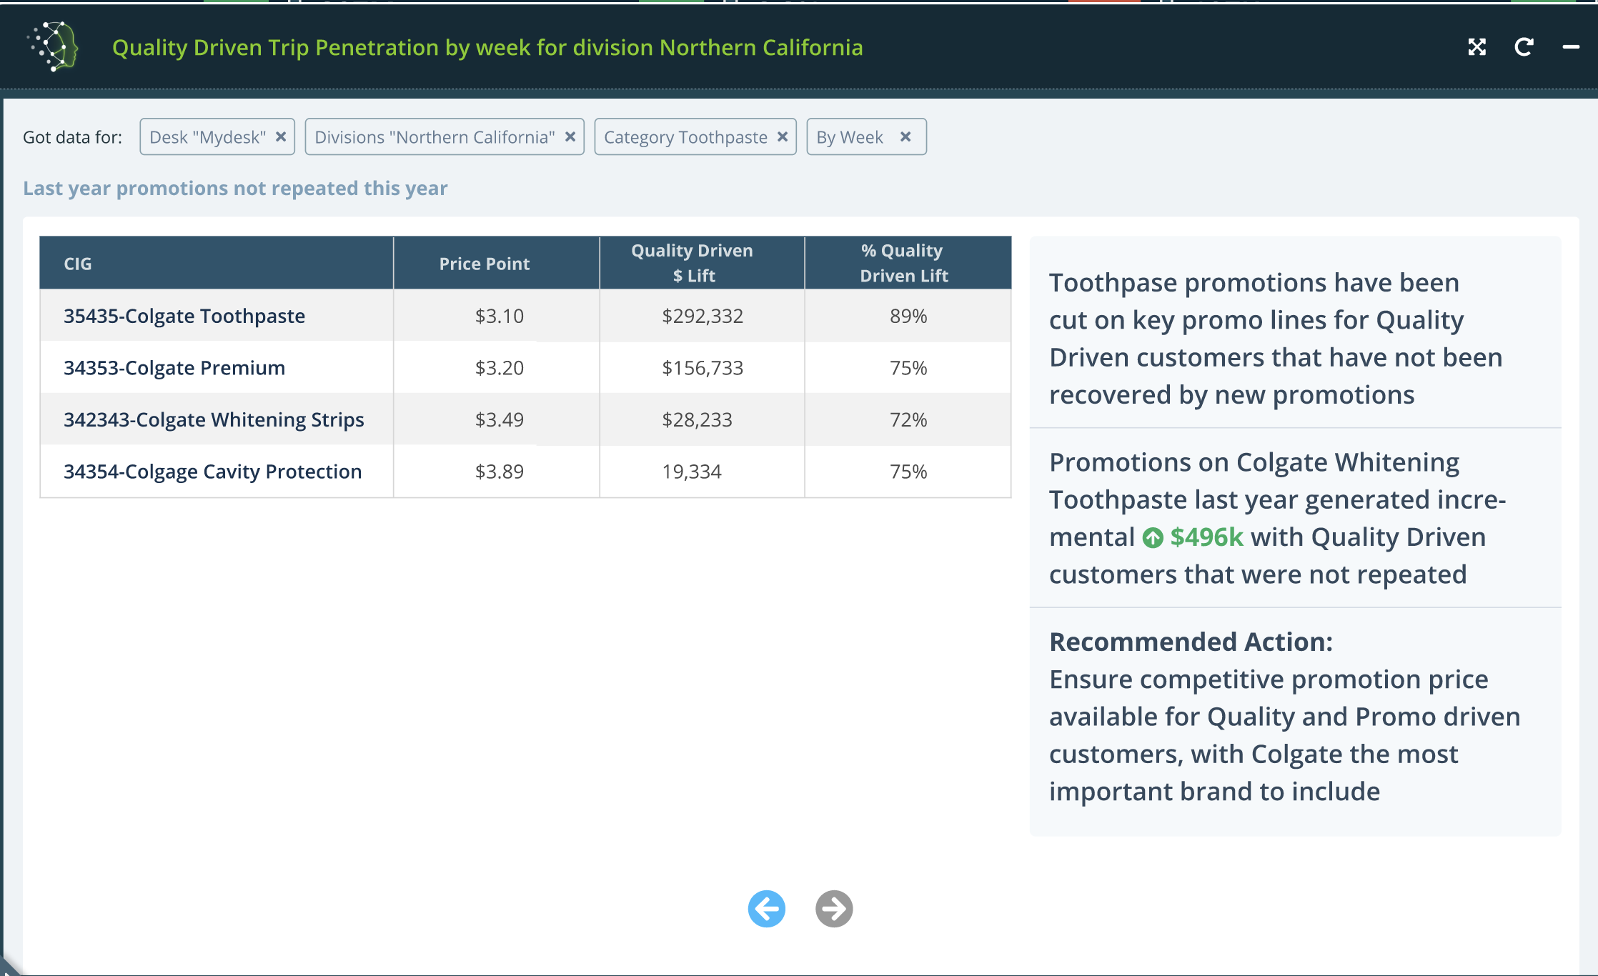
Key ingredients to deliver “Insights” (and data driven stories)
Create a story flow with a connected collection of components
5

Slide 7

IF (a big if) we have a “precooked” collection of components (apis, viualizations)
This would be a game of connecting the components and speed up the got live process
6
Lorem 3 ipsum
Lorem lorem
Ipsum 23%
Choose Visualization
Configure
Insights
Connect “Pages”
Choose API

Slide 8
BUT we need to create components
… we can speed it up via conventions
API conventions
Data format
API Access
Visualization conventions
Reusable for specific data shape
Reuse & reshape
Insights & annotation conventions
Easy connection to data
Easy prototyping

Slide 9
Story / App components
Intent
Scope
Flow
Data Driven Viz
Data driven insights
{
Id: pagex
intent: ‘abc’,
dataSource: http:x.y.com,
Visualization: ‘viz123’
Insights: {},
Flow: {next: paxey}
}
Supporting data

Slide 10
Intent
Scope (dynamic)
Data driven Viz
Data driven Insights
Data
api: http://dummycom/intent?scope=scope
{
field: data
}
I1
I2
I3

Slide 11
Title
Intent
showTrends
Insights
Visualization

Slide 12
Title
Intent
showTrends
Insights
Visualization

Slide 13
Insights
The most relevant department is ${mostRelDept}
B
C
- Abnormal sales
Added value Data
- Sales by department & period
- Most relevant items
Data

Slide 14
XYZ
Visualization
Data feed
Visualization
Report
Visualization
Intents

